Slide 1


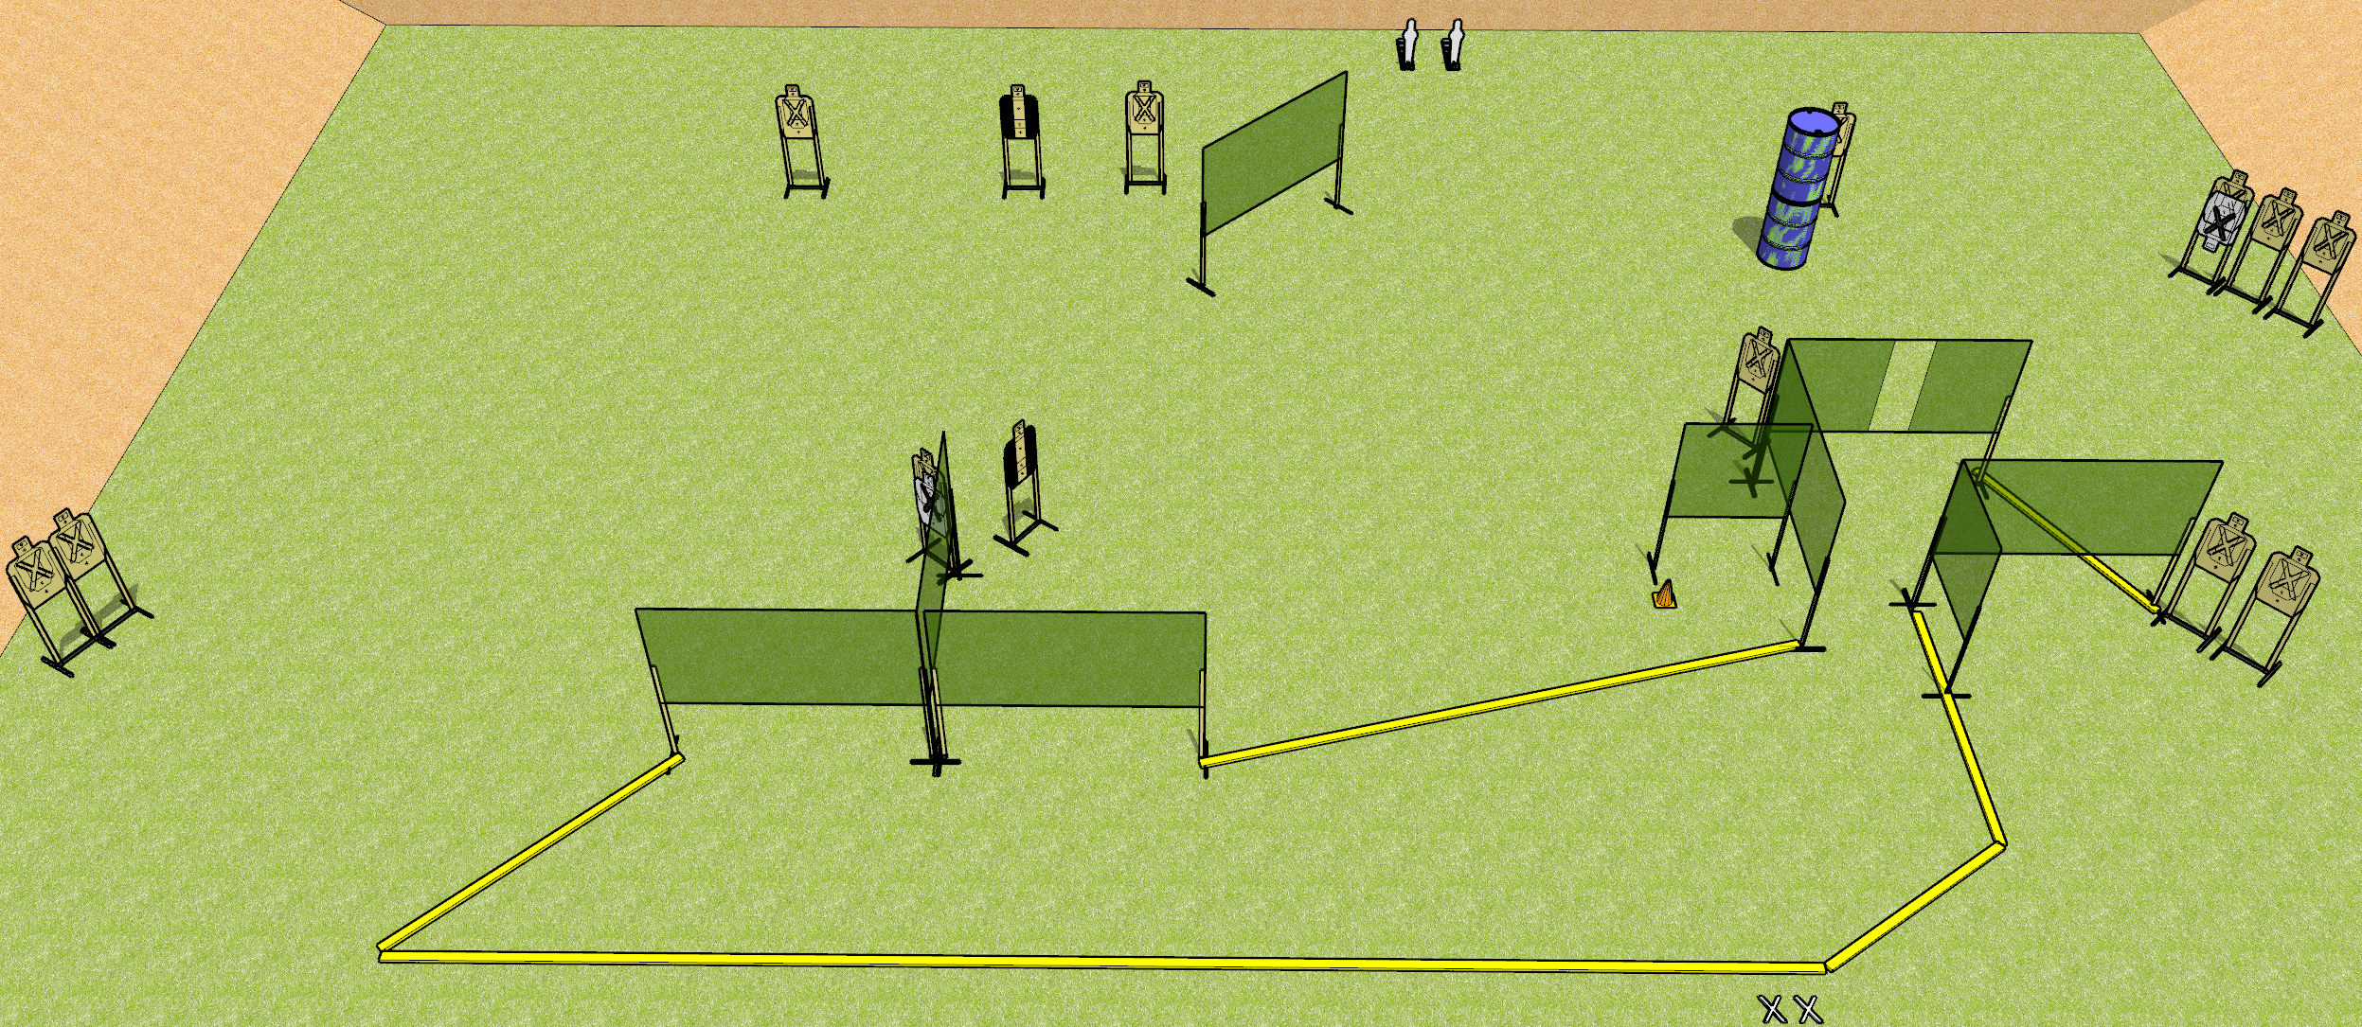
 | Dothan Gun Club – USPSA Match Quack! Course Designer : Drew Coleman
START POSITION : Standing with both feet on X’s, wrists below belt
GUN READY CONDITION : Pistol loaded and holstered. PCC loaded, held with both hands, shouldered, safety on, pointed at orange cone. |  | SCORING: Comstock, 30 rounds TARGETS: 14 paper, 2 Steel SCORED HITS: Best 2 on paper, steel until down START-STOP: Audible, last shot RULES:
STAGE PROCEDURE: Engage targets as they become available from within the fault lines.

Slide 2
Quack!
Written Stage Briefing
Quack! Is a 30 round, 150 point, Comstock field course. There are fourteen USPSA targets and two mini poppers. The best two hits on paper will score, and steel must fall to score. The start signal is audible.
Handgun start position is standing with both feet on X’s, wrists below belt. Handgun is loaded and holstered.
PCC start position is standing with both feet on X’s, muzzle pointed at orange cone. Loaded carbine is held with both hands, safety on, shouldered.
On start signal, engage targets as they become available from within the shooting area.

Slide 3
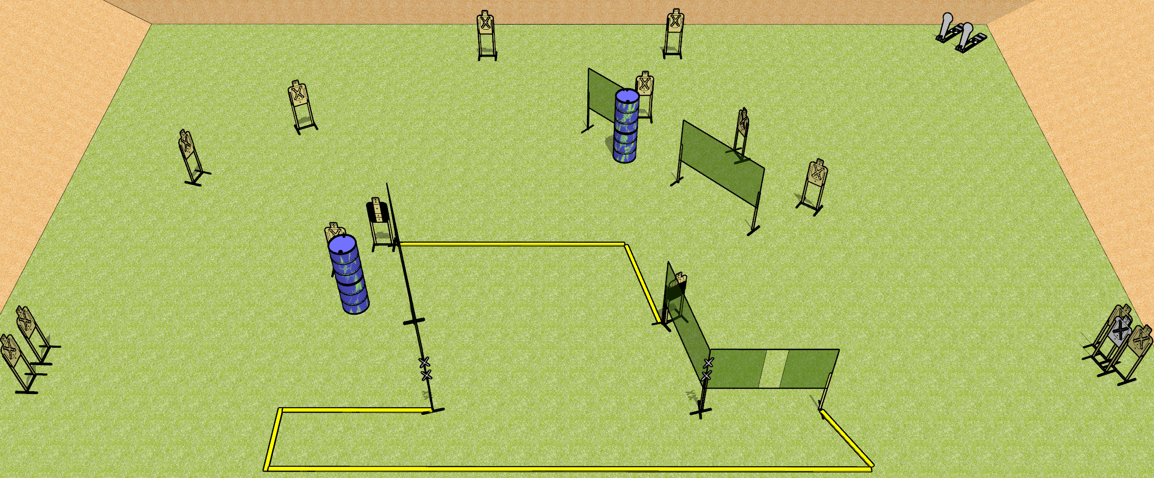
 | Dothan Gun Club – USPSA Match Touchy Touchy Course Designer : Drew Coleman
START POSITION : inside the shooting area with both hands touching either set of marks. PCC muzzle touching a mark.
GUN READY CONDITION : Pistol loaded and holstered. PCC loaded, held with both hands, shouldered, safety on, muzzle touching a mark |  | SCORING: Comstock, 30 rounds TARGETS: 14 paper, 2 Steel SCORED HITS: Best 2 on paper, steel until down START-STOP: Audible, last shot Notes: Marks are on the leftmost wall and the corner of the right two walls (reminder for setup in case the printout is hard to read)
STAGE PROCEDURE: Engage targets as they become available from within the fault lines.

Slide 4
Touchy Touchy
Written Stage Briefing
Touchy Touchy is a 30 round, 150 point, Comstock field course. There are fourteen USPSA targets and two Colt poppers. The best two hits on paper will score. The start signal is audible.
Handgun start position is inside the shooting area with both hands touching either set of marks. Handgun is loaded and holstered.
PCC start position is inside the shooting area with muzzle touching any mark. Loaded carbine is held with both hands, safety on.
On start signal, engage targets as they become available from within the shooting area.

Slide 5
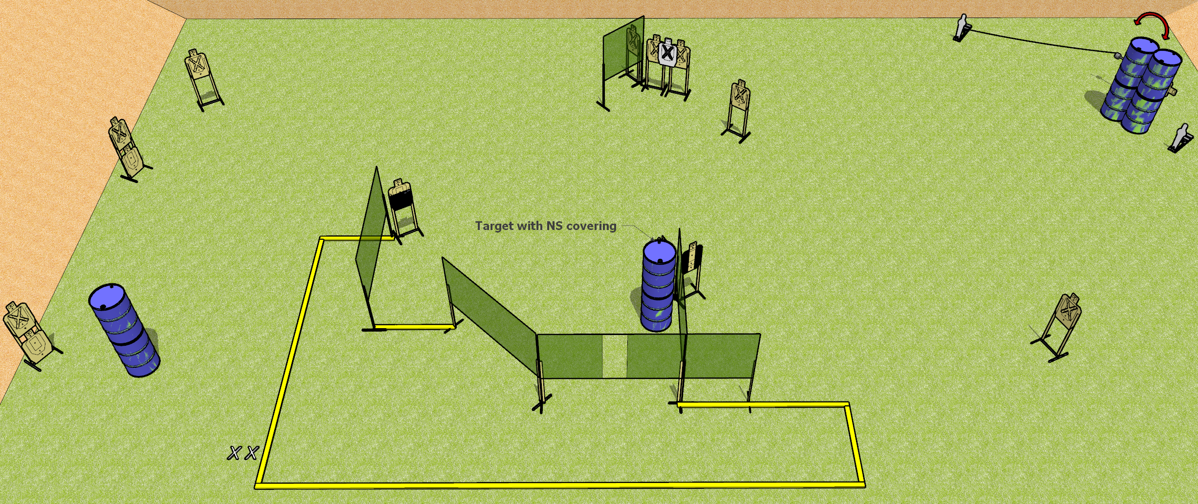
 | Dothan Gun Club – USPSA Match Steps Course Designer : Drew Coleman
START POSITION : Standing with both feet on X’s, wrists above shoulders
GUN READY CONDITION : Pistol unloaded and holstered. PCC unloaded, held with both hands, stock on belt. |  | SCORING: Comstock, 30 rounds TARGETS: 14 paper, 2 Steel SCORED HITS: Best 2 on paper, steel until down START-STOP: Audible, last shot RULES:
STAGE PROCEDURE: Engage targets as they become available from within the fault lines.

Slide 6
Steps
Written Stage Briefing
Steps is a 30 round, 150 point, Comstock field course. There are fourteen USPSA targets and two mini poppers. The best two hits on paper will score. Steel must fall to score. The start signal is audible.
Handgun start position is standing with both feet on X’s, wrists above shoulders. Handgun is unloaded and holstered.
PCC start position is standing with both feet on X’s. Unloaded carbine is held with both hands, buttstock on belt.
On start signal, engage targets as they become available from within the shooting area.

Slide 7
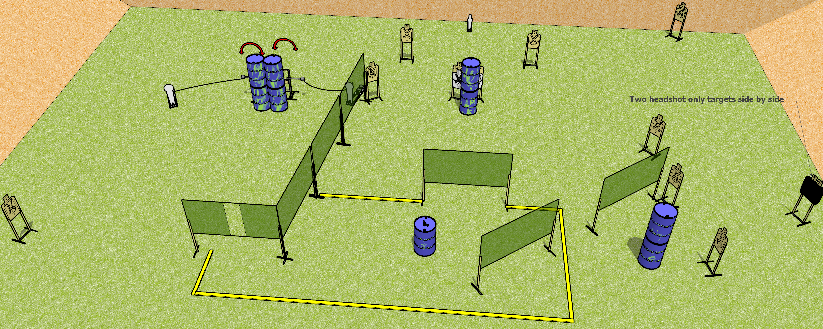
 | Dothan Gun Club – USPSA Match Grab that Gun Course Designer : Drew Coleman
START POSITION : Outside the shooting area
GUN READY CONDITION : Firearm loaded, safety on, muzzle pointed perpendicular to the back berm, placed unsupported on barrel in center of shooting area. |  | SCORING: Comstock, 31 rounds TARGETS: 14 paper, 3 Steel SCORED HITS: Best 2 on paper, steel until down START-STOP: Audible, last shot RULES:
STAGE PROCEDURE: Engage targets as they become available from within the fault lines.

Slide 8
Grab that Gun
Written Stage Briefing
Grab that Gun is a 31 round, 155 point, Comstock field course. There are fourteen USPSA targets, two Colt poppers, and one mini popper. The best two hits on paper will score, and steel must fall to score. The start signal is audible.
The left swinger is activated by the left Colt popper, and the right swinger is activated by the right Colt popper. Please check the activators prior to walkthrough and set the same way every time.
Start position is outside the shooting area. Firearm is laying unsupported on barrel in the shooting area, loaded, safety on, muzzle perpendicular to the back berm.
On start signal engage targets as they become available from within the shooting area.

